Slide 1

Stock Bridge: Achieve Your Financial Goals
Team - 12 G. Sahithi G. Chandra Lokesh

Slide 2
Problem Statement
Information Overload
Difficulty in Portfolio Management
Complexity in Stock Transactions
Investors struggle to keep up with market trends, stock performance, and financial news, making it difficult to identify profitable opportunities.
Managing investments and tracking favorite or purchased stocks can be cumbersome, especially in volatile markets.
Many platforms lack intuitive tools for discovering active stocks or buying and selling them seamlessly.

Slide 3
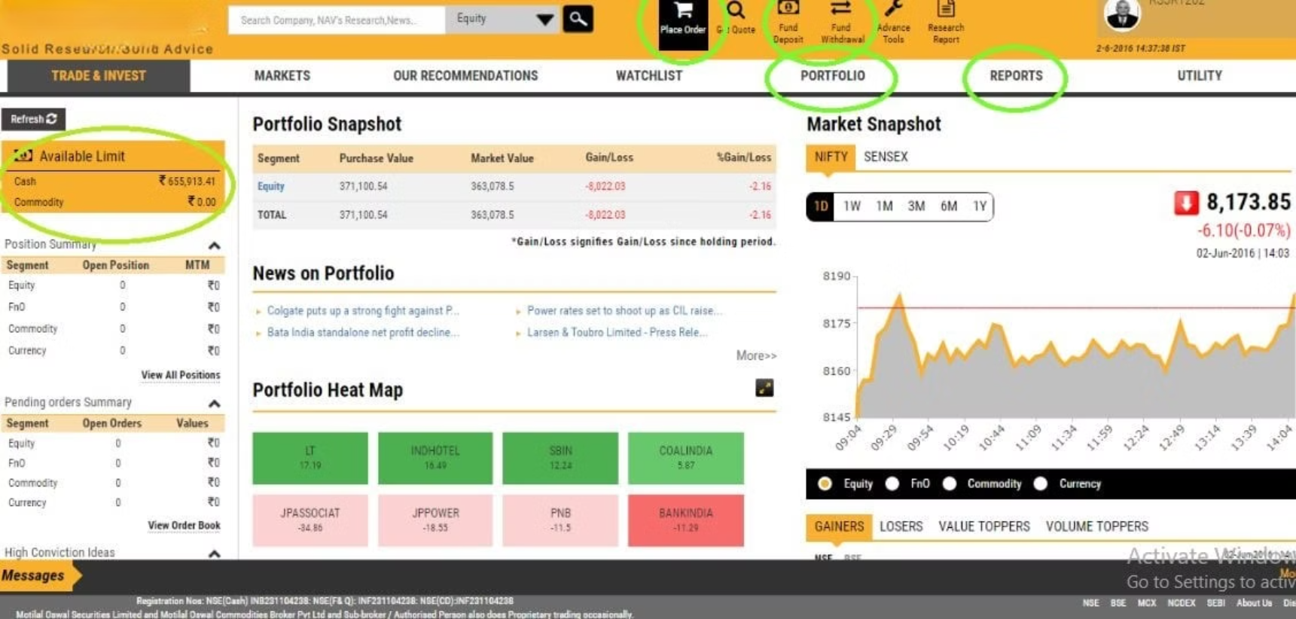
Example

Slide 4

Technology Stacks
Spring Boot
Angular
Microservices Architecture for Portfolio and Stock Management, Used PostgresSQL
For Frontend development and API interaction are done through Angular.
Public API's
Spring Security
Used Financial Modelling and Alpha Vantage Stock APIs for getting Real Time Information
User Authentication and Authorization done through spring security.

Slide 5
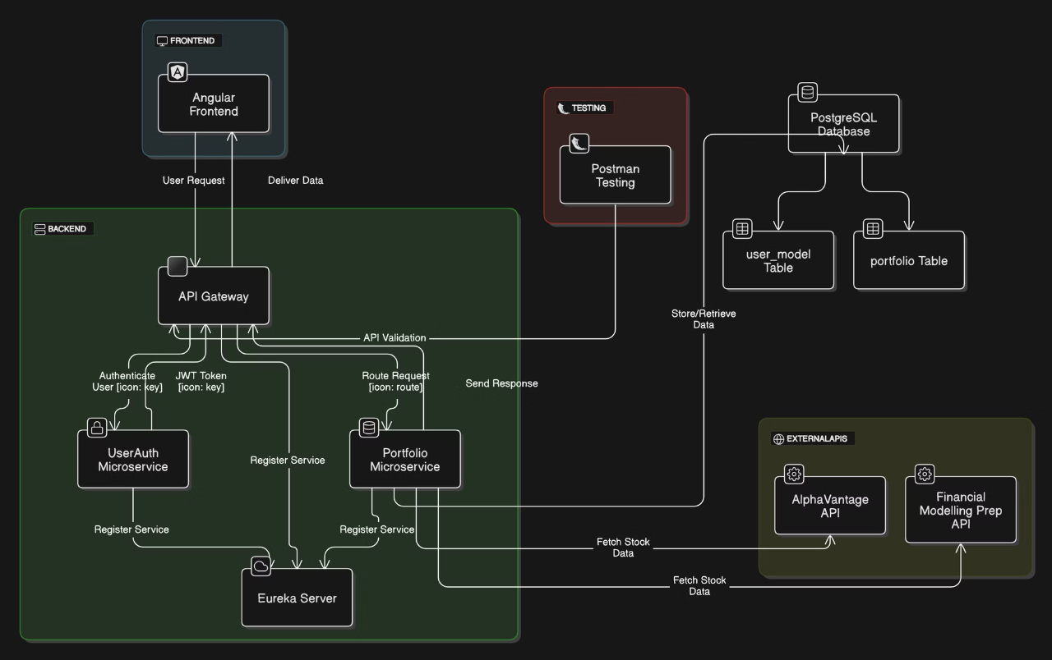
User Flow

Slide 6

Our Solution
1
Real-Time Insights
2
Easy Stock Discovery
Access up-to-the-minute market data, news, and analysis to make informed decisions.
Use powerful search tools to find investment opportunities aligned with your goals.
3
Portfolio Management
4
Educational Resources
Track your portfolio performance adjust your strategy based on real-time information.
Learn about investing basics, risk management, and financial planning through interactive courses and articles.

Slide 7



Conclusion
Simplified Investing
1
Our platform makes stock market investing accessible by providing real-time insights and seamless trading tools.
Effective Portfolio Management
2
Users can efficiently manage their investments with personalized dashboards and intuitive features.
Empowered Learning
3
By integrating educational resources, we enable users to make informed financial decisions and grow their investing knowledge.

Slide 8

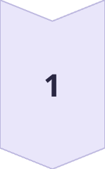
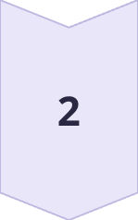
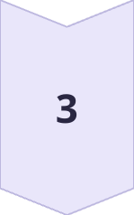
Future Enhancements
AI-Powered Recommendations
Leverage configured chatbot to provide personalized investment information tailored to your needs.
Notifications To User
Sending Notifications to User Regarding User Purchased Stocks and Watchlist
Social Investing
Connect with other investors, share insights, and collaborate on investment strategies.

Slide 9

Thank You

